Slide 1
Prístupové práva (Linux)
Laura Sopoligová 2024/2025

Slide 2
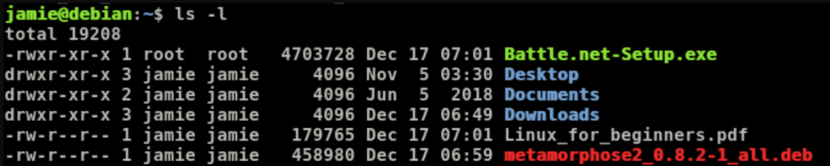
d → directory
l → link
- → file

Slide 3
Stĺpec – owner
Stĺpec - group

Slide 4
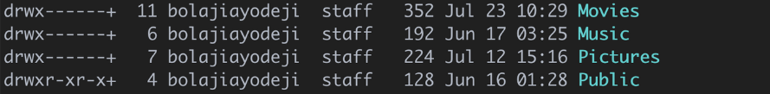
r – read
w – write
x - execute
Zelena – Owner
Tyrkysova - Group
Modra - Other

Slide 5
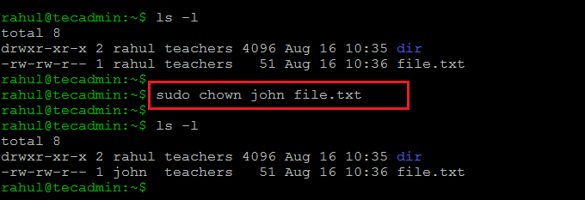
CHOWN – change owner

Slide 6
CHOWN – change owner

Slide 7
CHOWN – change owner
CHGRP – change group

Slide 8
CHMOD – change mode
OCTAL
SYMBOLIC

Slide 9
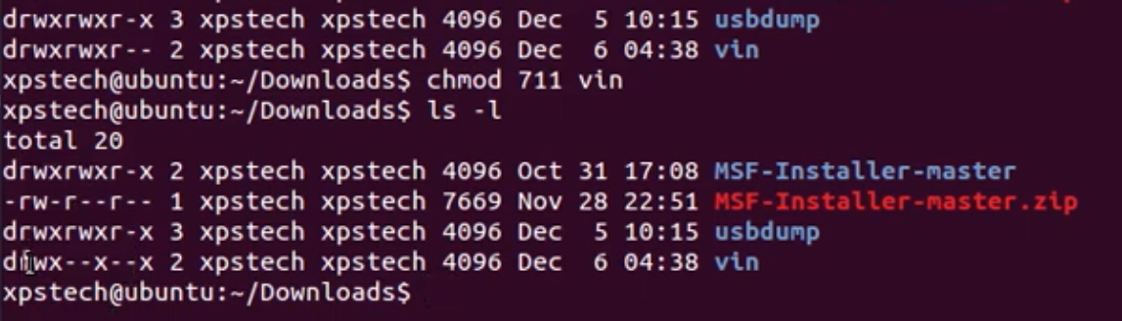
CHMOD – octal
R – 4 W – 2 X – 1
chmod 760 file01.txt

Slide 10
CHMOD – octal
R – 4 W – 2 X – 1
chmod 760 file01.txt

Slide 11
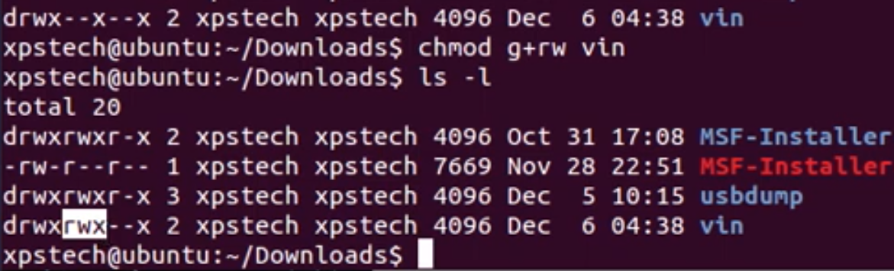
CHMOD – symbolic
a – all u – user o – other g – group
+ pridá - odoberie
chmod u-w file02.txt

Slide 12
CHMOD – symbolic
a – all u – user o – other g – group
+ pridá - odoberie
chmod u-w file02.txt

Slide 13
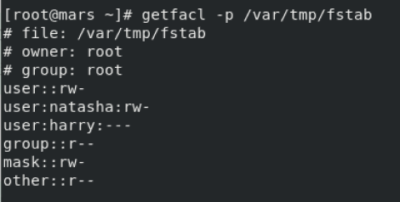
GETFACL – get file access control list

Slide 14
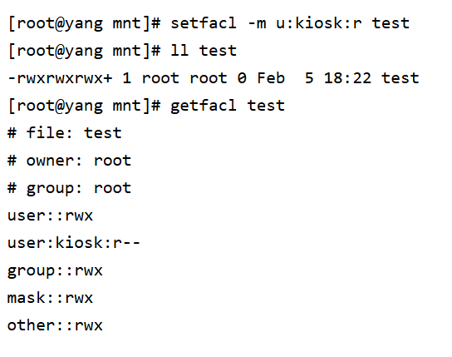
SETFACL – set file access control list
-m → modify
setfacl –m g:name:permission file.txt
g – group
u – user
o - other

Slide 15
Zdroje:
CHMOD-symbolic and octal: https://www.youtube.com/watch?v=MFQpdELKTLc
IT navody: https://itnavody.sk/blogy/software/pristupove-prava-suborov-v-unix-linux-os
Google images
Setfacl: https://www.youtube.com/watch?v=4Pnka4LV6fU
Setfacl, getfacl: https://www.youtube.com/watch?v=aIIgtFmWfzo
Getfacl picture: https://blog.csdn.net/u013669912/article/details/131435060
Setfacl image: https://blog.csdn.net/QwQ_QAQ/article/details/54882203?ops_request_misc=%257B%2522request%255Fid%2522%253A%25226B6159D1-62F8-498B-9356-D664D6F2729B%2522%252C%2522scm%2522%253A%252220140713.130102334..%2522%257D&request_id=6B6159D1-62F8-498B-9356-D664D6F2729B&biz_id=0&utm_medium=distribute.pc_search_result.none-task-blog-2~all~top_positive~default-1-54882203-null-null.142^v100^pc_search_result_base4&utm_term=setfacl&spm=1018.2226.3001.4187

Slide 16
Dakujem za pozornosť :-)

